Slide 1

Prompt Engineering: Unlocking the Power of Language Models
Prompt engineering is crucial for effective language model interaction. Mastering it unlocks the full potential of these powerful tools.

Slide 2

What is Prompt Engineering?
Defining Prompts
Prompt Types
Prompts are instructions given to a language model.
Different prompts elicit different responses.
Model Interaction
Prompts guide the model's output.

Slide 3

Understanding Prompt Design
1
Clarity
2
Specificity
A clear prompt ensures the model understands your request.
Specific prompts yield more precise and relevant results.
3
Context
Provide sufficient context for accurate model understanding.

Slide 4
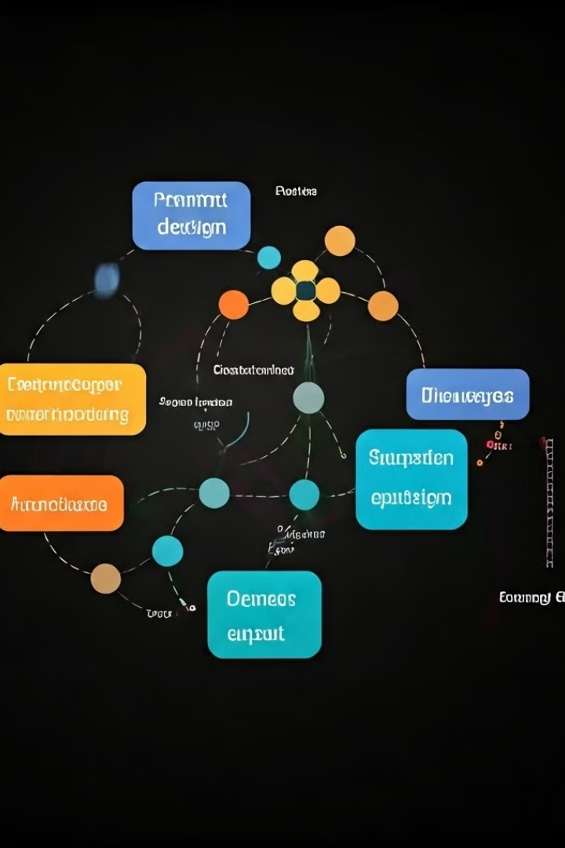
Importance of Prompt Design
1
Clear Instructions
2
Desired Output
Well-designed prompts yield accurate results.
Specify format, style, and length.
3
Efficiency
Reduce iterations, save time.

Slide 5
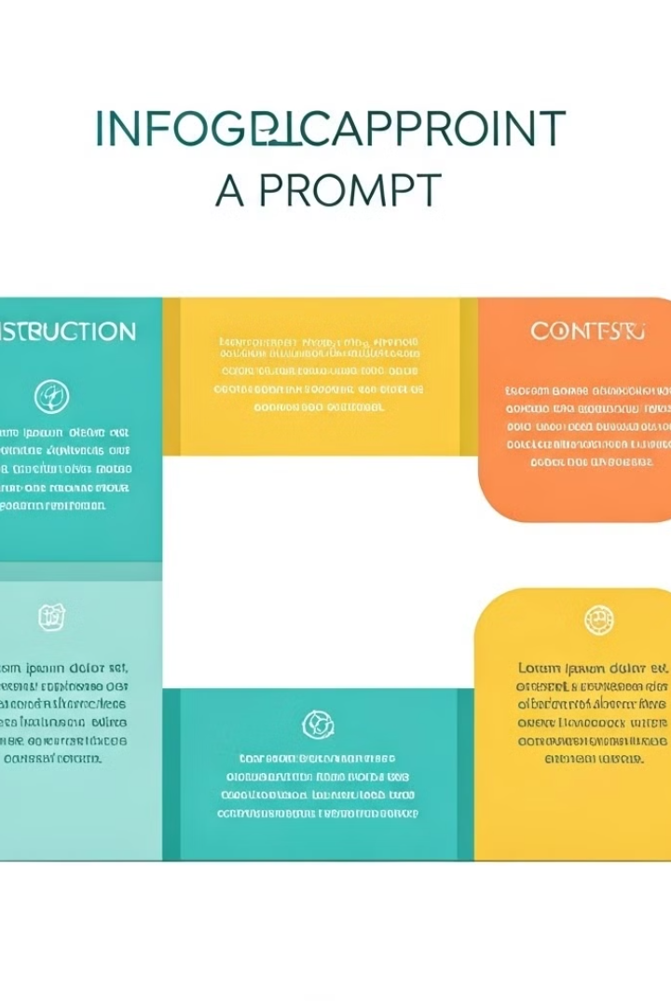
Prompt Anatomy: Structure and Components
Instruction
Context
Clearly state the desired task or outcome.
Provide background information, if needed.
Examples
Show the model what you expect.

Slide 6
Prompt Optimization Techniques
Few-shot learning
Chain-of-thought
Iterative Refinement
Provide a few examples to guide the model.
Break down complex tasks into smaller steps.
Refine the prompt based on the initial results.

Slide 7




Prompt Crafting Techniques
Specificity
Precise instructions for better results.
Context
Provide background information.
Examples
Illustrate desired output.

Slide 8


Prompt Experimentation and Iteration
Experiment
Try different phrasing and structures.
Analyze
Evaluate the model's responses.
Refine
Adjust the prompt for better results.

Slide 9




Ethical Considerations in Prompt Engineering
Bias Mitigation
Address biases in prompts and models.
Data Privacy
Protect sensitive information.
Misinformation
Prevent generation of false info.

Slide 10

Avoiding Common Prompt Pitfalls
Ambiguity
Unclear instructions
Vagueness
Lack of detail
Bias
Leading or unfair prompts

Slide 11
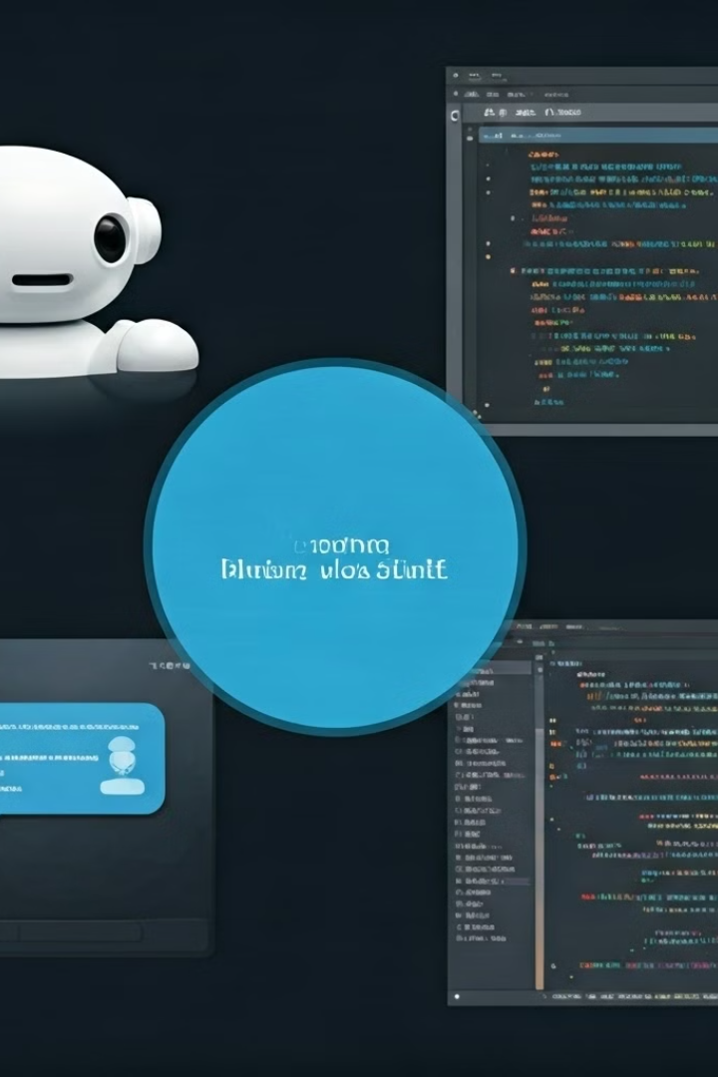



Prompt Engineering for Specific Applications
Chatbots
Create engaging and informative conversations.
Code Generation
Generate efficient and readable code.
Text Summarization
Produce concise and accurate summaries.

Slide 12

The Future of Prompt Engineering
1
Advanced Models
More powerful and versatile models.
2
Automated Prompting
Tools to optimize prompts automatically.
3
Specialized Techniques
New methods for specific tasks.

Slide 13
Sample Code for Prompt Engineering
import openai
# Replace this with your own API key from OpenAI
openai.api_key = "sk-9-WnGCQpn9-KLso3hkUq0pY4cgcJ7PljcHSTWbMeQRT3BlbkFJZnyFz2XCEbIu1aFdnoBfwUqv4Pza94629WBB0vq44A"
# Function to get a response from ChatGPT
def chat_with_gpt(prompt):
try:
response = openai.Completion.create(
engine="text-davinci-003", # Choose the GPT engine, e.g., "gpt-3.5-turbo" or "text-davinci-003"
prompt=prompt,
max_tokens=150, # Limit the length of the response
n=1, # Number of responses to generate

Slide 14
Continuation
stop=None, # You can set a stopping condition, e.g., ['\n'] for multi-line responses
temperature=0.7 # Control the randomness of the response (0.0 - most deterministic, 1.0 - most creative)
)
# Extract the response text
reply = response.choices[0].text.strip()
return reply
except Exception as e:
return f"An error occurred: {e}"
# Example usage
if __name__ == "__main__":
user_prompt = input("You: ")
bot_response = chat_with_gpt(user_prompt)
print(f"ChatGPT: {bot_response}")

Slide 15
Input and Output:
User Prompt: "What is the capital of France?"
Generated Response:
You: What is the capital of France?
ChatGPT: The capital of France is Paris.
If you run the code in your terminal or command line:
$ python chatgpt_example.py You: What is the capital of Japan?
ChatGPT: The capital of Japan is Tokyo.

